Slide 1

Least Privilege
Security First Principles
Wyatt Tauber
November 27th, 2023
Notes:
In this module, we are going to discuss system privileges.
Specifically - how to secure and exploit them
How the principle of least privilege plays into security first design

Slide 2
Three Main Ideas
What are privileges and permissions and how are they implemented?
How is security first design supported by the principle of least privilege?
What role does access control play in security first design?
What role do security models play in security first design?
What are privilege escalation vulnerabilities, and how are they introduced when the principle is not followed?
Notes:
Our main ideas for this module are:

Slide 3
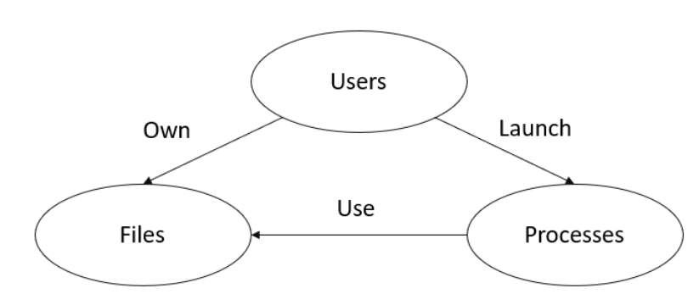




Contents
Privileges and Permissions
What is a Privilege?
Components with Privileges
What is Least Privilege”?
Windows Privilege Configuration Tools
Linux Privilege Configuration Tools
Security Models
What is a Security Model?
Bell-LaPadula (BLP)
Biba
Clark-Wilson (CW)
Access Control
What is Access Control?
Role Based Access Control (RBAC)
Rule Based Access Control (RuBAC)
Mandatory Access Control (MAC)
Discretionary Access Control (DAC)
Attribute Based Access Control (ABAC)
Privilege Escalation
What is Privilege Escalation?
Horizontal Privilege Escalation
Vertical Privilege Escalation
Windows Configuration Errors
Linux Configuration Errors
“No read up, no write down”
“No read down, no write up”

Slide 4

Privileges and Permissions
Concepts
Components
Configuration Tools
Notes:
First, we’ll discuss the general concept of privileges and permission
The components of operating systems that rely on them for various functions
And privilege configuration (management/monitoring) tools on Windows and Linux

Slide 5
What is a Privilege?
A privilege is the ability of a user or service to act on managed computer resources.
In cybersecurity, the term is used interchangeably with permission.
Notes:
Put quite simply, a “privilege” is the ability of a user or service to act on managed computer resources.
It can also be used interchangeably with the term permission, or in less common cases, “right”.
Users, files, and processes are the foundational components of most operating systems.
These generally have standard privileges, including users owning files and launching processes.
These processes, in turn, use the files that users own.

Slide 6
Components with Privileges
Users own files and have privileges to read/modify/delete files and resources owned by others following the rules of a security model.
Administrators (Windows) and root (Linux) have the greatest privileges on a system.
SYSTEM (Windows) is an administrator account used by the operating system and services.
Standard users (Windows)/non-sudoers (Linux) have access to their files and processes and those they are granted access to by others.
Processes generally operate with the privileges of the user that runs them, though there are exceptions:
Linux users can run processes as root using sudo (if they are in the sudoers file) and they can run processes as other users by using su or runuser or if the SUID/SGID bit is set on the executable.
Windows users can use the “Run As” (RunAs) dropdown option or command.
Services can also be configured to run as a different user or SYSTEM with the proper privileges.
All of these methods require the secondary logon (seclogon) service to be running.
File ownership and permission usually follow some form of security model or access control.
Notes:
However, this simple model can quickly get very, very nuanced.
And the exact implementation of privilege will vary by operating system, version, distro, configuration, or deployment.
For example, users, while they do own files, they also:
In another case, processes are launched by users and will typically run with the permissions of the user who launched them, but:
Finally, files are owned by users and used by processes, but exactly how will depend on:

Slide 7
What is Least Privilege?
The Principle of Least Privilege includes:
Minimizing the number of privileges granted to a user for accomplishing assigned duties
Disabling privileges that are unused or not required for accomplishing assigned duties
These actions improve accountability and limit the potential for accidental or intentional privilege escalation (PrivEsc).
Operating systems may frequently prompt users to elevate their privilege for tasks that have high consequences, such as installing software or deleting a system file.
Notes:
The Principle of Least Privilege includes:
These actions…
The most obvious example of a least privilege implementation is when operating systems…

Slide 8
Windows Privilege Configuration Tools
Component | Standard Management/Monitoring Tool(s)
Users | Local Users and Groups User Account Control AccessChk, AccessEnum – SysInternals
Processes | Process Explorer, Process Monitor - SysInternals Memory Integrity – Defender
Services | Services MSC Autoruns – SysInternals
Files | Properties > Security > Advanced Security Settings Local Security Audit Policy Controlled Folder Access – Defender
Registry | Registry Editor
Notes:
There are quite a few GUI and command-line tools in Windows used for privilege configuration, management, or monitoring:
_____ configuration is usually done through:

Slide 9
Linux Privilege Configuration Tools
Component | Standard Management/Monitoring Tool(s)
Users | /etc/passwd /etc/sudoers User Mapping – SELinux SUID, SGID
Processes | Capabilities Process Domain – SELinux cvechecker
Services | service cron
Files | chmod setfacl File Labeling – SELinux Sticky Bit
Notes:
In contract to Windows, the privilege configuration, management, and monitoring tools for Linux are usually file or command-line based.
_____ configuration is usually done through:

Slide 10

Security Models
Concept
Classic Types
Notes:
Security models are one way that we can enforce the principle of least privilege, as well as gain some additional benefits.

Slide 11
What is a Security Model?
Security models define rules of behavior for an information system to enforce policies related to system security.
Typically involve confidentiality and/or integrity policies of the system
Define allowable behavior for one or more aspects of system operation
Technology enforces rules of behavior to ensure security goals
Most OSs implement elements of these security models.
Not perfect implementations of the academic models
Practical implementations which are functionality consistent
Subject-Object Notation
S is a subject, O is an object
Property denoted by P(O) and P(S)
Notes:
Security models define…
These…
Most OSs implement elements of these security models, but…
When discussing security models, we will use subject-object notation.
If you haven’t seen it before, it’s not too bad. S and O are subjects and objects, and properties of each are defined with a letter like P.
Now, we can create associations between subjects, objects, and their properties.

Slide 12
Bell-LaPadula (BLP)
The Bell-LaPadula model describes essential requirements for multilevel security (MLS).
Assigns a security label (L) to subjects and objects
Defines rules for interactions between them
Concerned with confidentiality
Intended to prevent unauthorized reading
“No read up, no write down”
Property | Condition
Simple Security | S can read O if and only if L(O) ≤ L(S)
Star (*) | S can write O if and only if L(S) ≤ L(O)
Strong Star (**) | S can write O if and only if L(S) = L(O)
Notes:
“Bell Lah-Pad-u-lah” (or “Bell Law-Pah-doo-lah”, both seem to be acceptable pronunciations in industry) was one of the first formally defined security models.
It was created to describe essential requirements for the Department of Defense’s multilevel security policy, or MLS.
The BLP model assigns… and defines…
It is concerned with… and intends to…
The properties defined in this model are:
Simple Security property. A subject with this property cannot read/access an object of a higher classification (i.e., no read up).
Star property. A subject with this property can only save an object at the same or higher classification (i.e., no write down).
Strong Star property. A subject with this property can only write to objects at the same security classification level as the subject (i.e., lateral write, no write down and no write up).
These can be simply summarized by the phrase “No read up, no write down.”

Slide 13
Biba
The Biba model describes essential requirements for state consistency and data validation.
Assigns an integrity level (I) to subjects and objects
Defines rules for interactions between them
Concerned with integrity
Intended to prevent unauthorized writing
“No read down, no write up”
Property | Condition
Simple Integrity | S can read O if and only if I(S) ≤ I(O)
Star (*) | S can write O if and only if I(O) ≤ I(S)
Invocation | If S reads O, then I(S) = min(I(S), I(O))
Notes:
Biba is a formal state transition system for cybersecurity policies, designed to be the inverse of BLP.
The Biba model assigns… and defines…
It is concerned with… and intends to…
The properties defined in this model are:
Simple Integrity property. A subject with this property cannot read or observe an object of lower integrity (i.e., no read down).
Star property. A subject with this property cannot modify an object of higher integrity (i.e., no write up).
Invocation property. A subject with a lower integrity level cannot request access to a higher integrity level object, only to objects at an equal or lower integrity level.
These can be simply summarized by the phrase “No read down, no write up.”

Slide 14
Clark-Wilson (CW)
The Clark-Wilson model improves the Biba model by describing its properties at the transaction level.
Assigns a subject-program-object binding for each transaction
Defines rules of two types guaranteeing system integrity
Concerned with separation of duties
Intended to prevent undesirable changes by authorized subjects
Rule Type | Description
Certification | Must separate duties between certification and enforcement When verification is executed, it guarantees all data are valid For some data, a transformation must produce valid data For all unverified data, a transformation must produce verified data or reject All transformations must log sufficiently to recreate operation
Enforcement | Must maintain list of triples and ensure only certified transformations are run. Must authenticate users. Verify that authenticated users are authorized to run a transformation on a data. Only the certifier for a transformation may change triples associated w/ that transformation.
Notes:
The Clark-Wilson model improves the Biba model by describing its properties at the transaction level.
The CW model assigns… and defines…
It is concerned with… and intends to…
There are 9 rules across two types associated with CW.
We aren’t going to go through them all, but:
Certification rules lay out how the system certifies that a particular data object is in a valid state (according to another set of rules)
Enforcement rules make sure that already-certified data object stays certified (maintains its integrity) as the system interacts with it

Slide 15


Access Control
Concept
Types
Notes:
Access control is another way that we can enforce the principle of least privilege. There are several types.

Slide 16
What is Access Control?
Access control methods are formal presentations of the security policies enforced by the operating system.
Useful for proving theoretical limitations of systems
Bridge the gap in abstraction between policy and mechanism through duties
Security models align with access control methods to enforce policies, supporting the principle of least privilege.
Duty Type | Description
Fundamental (Atomic) Objects Security parameters | Read, write to or modify, create, delete and execute Read, define or change security parameters associated with an object, or affect how these properties are inherited by other objects or subjects that use it in any way
Complex | Sequences of fundamental operations
Notes:
Access control methods are formal presentations of the security policies enforced by the operating system.
They are…
Security models align with access control methods to enforce policies, supporting the principle of least privilege.
There are two duty types in most access control implementations:
Fundamental
Objects – read, write, modify, create, delete, execute
Security parameters – same operations
Complex – sequences of fundamental operations

Slide 17
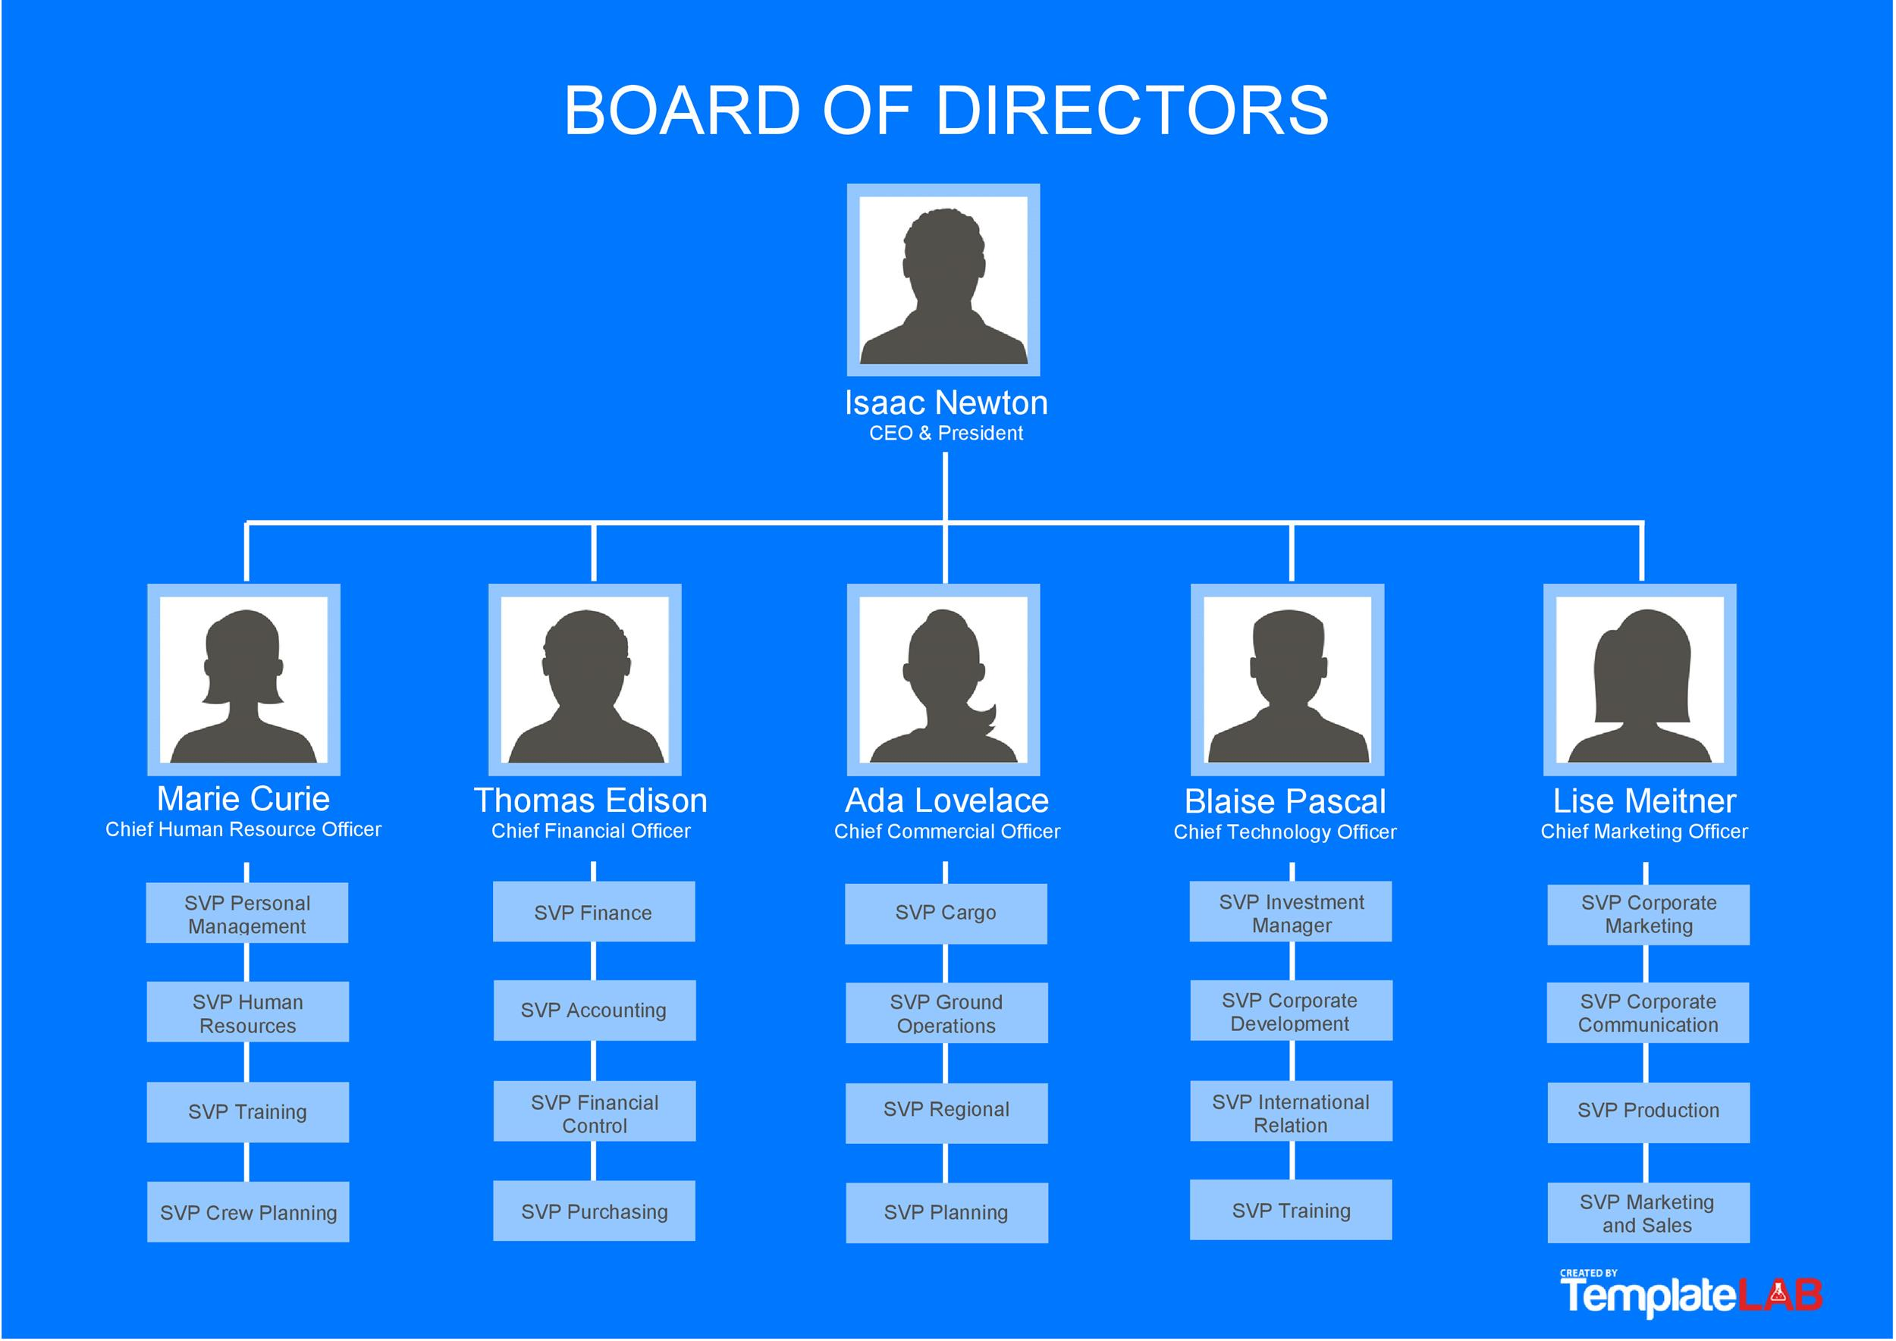
Role Based Access Control (RBAC)
In Role Based Access Control, the roles assigned to groups of users by systems administrators determine access privileges.
Centralized management (+)
Consistent deployments
Ease of compliance
Limited policy scope
Understandable and auditable (+)
Each policy may not intuitively align with a role (-)
Significant overhead (-)
Each account requires a role
New policies require new role creation
In many ways, RBAC is like an org chart.
Notes:
In Role Based Access Control, the roles assigned to groups of users by systems administrators determine access privileges.
RBAC is an AC policy that restricts information system access to authorized users. Organizations can create specific roles based on job functions and the authorizations (i.e., privileges) to perform needed operations on organizational information systems associated with the organization-defined roles.
In many ways, RBAC is like an org chart.

Slide 18
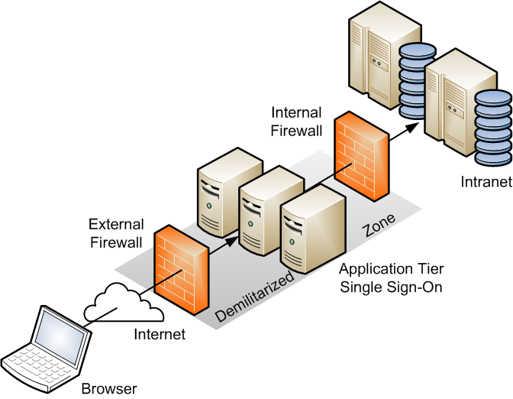
Rule Based Access Control (RuBAC)
In Rule Based Access Control, rule lists define access parameters and apply to all subjects and objects equally.
Flexible and granular rules (+)
Open-ended
Customizable
Scope is easily adjustable
Rigid (-)
Strict adherence to rules
May not be able to account for exceptions
Typically contain implicit deny
RuBAC is frequently implemented as ACLs.
Notes:
In Rule Based Access Control, rule lists define access parameters and apply to all subjects and objects equally.
RuBAC is a predefined list of rules to determine access with additional granularity controls such as when, where and if the system will allow read, write or execute on special conditions. RuBAC is managed by the system owner. These rules are often expressed in Boolean logic terms and can be quite complex and specific.
RuBAC is frequently implemented as ACLs.

Slide 19

Mandatory Access Control (MAC)
In Mandatory Access Control, access permissions and restrictions are enforced by the operating system based on a security hierarchy.
Best model for enforcing least privilege (+)
Implemented by many security models
Added to Linux via SELinux
Standardized format
Keeps security and data consistency high (+)
Rigid format due to a finite number of classifications (-)
Significant overhead (-)
Every subject and object needs a security classification
Military and government organizations typically use MAC.
Notes:
In Mandatory Access Control, access permissions and restrictions are enforced by the operating system based on a security hierarchy.
In this model, AC policy decisions are made by a central authority and not by the individual owner of an object. The user cannot change access rights.
Military and government organizations typically use MAC.

Slide 20

Discretionary Access Control (DAC)
In Discretionary Access Control, the data owner has full control over objects they create, and they assign specific privileges to other users.
Default access control method in most OSes (+)
Windows and macOS file systems default to DAC
Linux distros without SELinux may also default to DAC
Not standardized
Doesn’t require formal roles (+)
Implicitly trusts every user (-)
Not scalable (-)
Poor management of resources
Increased burden on users
In DAC, users set their own access rules.
Notes:
In Discretionary Access Control, the data owner has full control over objects they create, and they assign specific privileges to other users.
DAC leaves a certain amount of AC to the discretion of the object’s owner or anyone else who is authorized to control the object’s access. The owner can determine who should have access rights to an object and what those rights should be. DAC allows for the greatest flexibility of control, but it is also the most vulnerable form of access control. The object’s owner can pass on control weaknesses that can contribute to access and privilege aggregation. Many of the commercial OSs used on endpoint devices, such as Windows and Android, use forms of DAC so that purchasers (individual or organizations) can choose how to tailor these controls to their own needs.
In DAC, users set their own access rules.

Slide 21

Attribute Based Access Control (ABAC)
In Attribute Based Access Control, the attribute(s) assigned to groups of users by systems administrators determine access privileges.
Very flexible (+)
Provides a wide range of nuance in attribute creation and assignment
Works well in remote and cloud environments
Attributes are not related to organization structure
Easy management and maintenance (+)
Difficult to organize and control without routine management (-)
ABAC is very similar to RBAC but applies multiple attributes instead of a single role.
Notes:
In Attribute Based Access Control, the attribute(s) assigned to groups of users by systems administrators determine access privileges.
ABAC is an AC paradigm whereby access rights are granted to users with policies that combine attributes together. The policies can use any type of attributes (e.g., user attributes, resource attributes, environment attributes). ABAC is a simpler form of RuBAC.
ABAC is very similar to RBAC but applies multiple attributes instead of a single role.

Slide 22
Privilege Escalation
Concepts
Techniques
Configuration Errors
Notes:
Now that we’ve covered privilege, security models, and access control, what happens when something is misconfigured?
Typically, this exposes the system to a privilege escalation vulnerability.

Slide 23
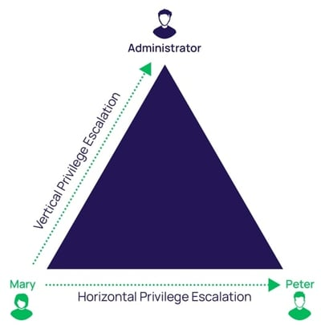
What is Privilege Escalation?
Privilege escalation (PrivEsc) is the act of exploiting a bug, a design flaw, or a configuration error to gain unauthorized access into a system and access additional rights, permissions, entitlements, privileges, or resources that are normally protected from an application or user.
Privilege escalation is typically part of the middle steps of the cyber kill chain, after initial access to the network is obtained.
Exploitation
Installation
Techniques:
Horizontal PrivEsc
Vertical PrivEsc
Notes:
Privilege escalation (PrivEsc) is the act of exploiting configuration errors to gain unauthorized access into a system.
It is typically part of the middle steps of the cyber kill chain, after initial access to the network is obtained.
There are two techniques for privilege escalation: horizontal (user to user) and vertical (user to administrator).

Slide 24
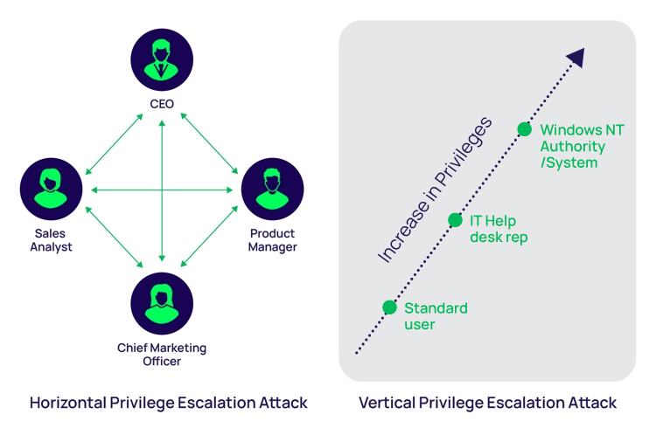
Horizontal Privilege Escalation
Horizontal PrivEsc involves accessing another user’s account and abusing the legitimate privileges granted to them.
Also called lateral movement or account takeover
Can be easier to obtain access to protected enclaves than going through administrator or root accounts first
Payroll and HR often have access to specific systems containing employee personally identifiable information (PII).
Engineering staff may have access to proprietary company information, including trade secrets.
Construction, maintenance, and janitorial staff may have access to building design blueprints.
Notes:
Horizontal PrivEsc involves…
It is also called…
Can be easier to obtain access to protected enclaves through horizontal PrivEsc than vertical PrivEsc.
For example…

Slide 25
Vertical Privilege Escalation
Vertical PrivEsc involves increasing privileges by obtaining access to administrative or root level user or service accounts.
Attackers typically use initial access accounts to search for other accounts with these higher privileges, or accounts through which they can pivot to them.
If the attacker can get this level of access, they can control or add services that start with the privileges of the system itself.
MITRE ATT&CK defines 14 different techniques for vertical PrivEsc under ID TA0004, including those outlined next.
Notes:
Vertical PrivEsc involves increasing privileges by obtaining access to administrative (on Windows) or root (on Linux) user or service accounts.
Attackers typically…
If the attacker…

Slide 26
Windows Configuration Errors
Common Windows Configuration Errors leading to Privilege Escalation
Privileged services editable by standard users | Service executables modifiable by standard users
Registry editable by standard users | Unquoted service paths
Passwords stored in text files | Insecure local administrator accounts
Unprotected Security Account Manager (SAM) | Third party apps that launch SYTEM-level processes or shells
Notes:
There are quite a few configuration errors in Windows that can be abused to obtain PrivEsc. Here are some of the most common ones:

Slide 27
Linux Configuration Errors
Common Linux Configuration Errors leading to Privilege Escalation
System-wide cronjobs with editable paths | Folder with write permissions in PATH
Programs with significant capabilities | Insecure sudoers configuration
Improper use of SUID/SGID/Sticky Bit | Passwords stored in text files
Allowing SSH as root | PAM misconfiguration
Notes:
There are also quite a few configuration errors in Linux that can be abused to obtain PrivEsc. Here are some of the most common ones:

Slide 28
Conclusion
Review: Three Main Ideas
Lab: Privilege Escalation
Additional Resources
Notes:
This concludes the lecture for this module, so let’s review.

Slide 29
Review: Three Main Ideas
A privilege is the ability of a user or service to act on managed computer resources.
Privileges are typically implemented on users and processes.
Privileges affect access to and the ability to act on files and other resources.
The principle of least privilege supports security first design by minimizing the number of privileges granted to a user for accomplishing assigned duties and disabling privileges that are unused or not required for accomplishing assigned duties.
Access control methods are formal presentations of the security policies enforced by the operating system.
Security models align with access control methods to enforce policies, supporting the principle of least privilege.
Horizontal and vertical privilege escalation (PrivEsc) vulnerabilities exploit configuration errors to gain unauthorized access into a system and access additional privileges or resources when the principle is not followed.
Notes:
We know that…

Slide 30
Lab: Privilege Escalation
Lab Description: In this lab, you will investigate, exploit, and correct many common vulnerabilities that may result from not adhering to the security first principle of least privilege. This lab will span both Windows and Linux privilege escalation techniques.
Lab Environment: The instructor has shared the “csc840-securityfirst” vApp with you in DSU’s IALab. Clone the vApp to your account before starting it or making any changes so you can revert if needed.
You are free to install whatever tools you would like to complete the assignment. Several potentially helpful tools are pre-installed on the Linux Exercises VM if needed:
gcc/make
Metasploit
SCP server
Box Name | Type | Lab Credentials
Linux Exercises | Kali 2023.3 | student / Password1!
Windows Exercises | Windows 10 Pro build 19044 | student / Password1!
Notes:
In the lab for this module…

Slide 31
Additional Resources
Privileges and Permissions
Introduction to Cybersecurity First Principles - Least Privilege
Windows
Hidden Danger: How To Identify and Mitigate Insecure Windows Services
Linux
Linux permissions: SUID, SGID, and sticky bit
Chapter 12. Managing sudo access
Security Models
Introduction To Classic Security Models
Access Control
Verification and Test Methods for Access Control Policies/Models
Comparing Access Control: RBAC, MAC, DAC, RuBAC, ABAC
Privilege Escalation
What Is Privilege Escalation? - ProofPoint
What is Privilege Escalation? - CrowdStrike
Understanding Privilege Escalation and 5 Common Attack Techniques
Windows
Privilege escalation on Windows: When you want it and when you don’t
Linux
A Guide On Linux Privilege Escalation - The Journey Towards System Control

